Slide 1
The fun stuff
GPCRs
Modulation
Plasticity
Learning

Slide 2
Who am I?
Paul Kramer
paul.kramer@nih.gov
Post-doc in Zayd Khaliq’s lab, NINDS (cellular neurophysiology unit)
Completed thesis in 2016 with John Williams at the Vollum Institute in Portland, Oregon
Studied mGluR modulation of dopamine neurons

Slide 3
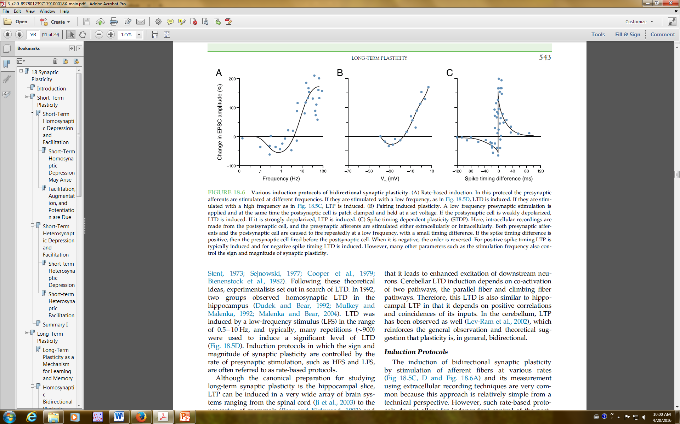
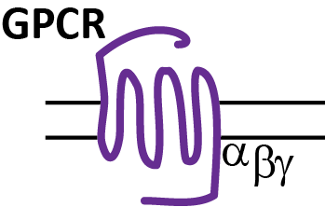
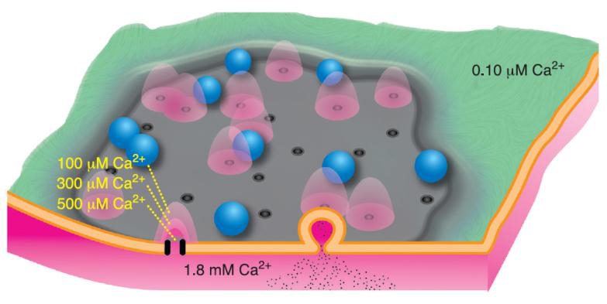
Final classes overview
Class 1:
GPCRs and Modulation
Class 2:
Presynaptic Plasticity
Class 3:
Postsynaptic Plasticity

Slide 4
GPCRs are the most important proteins in the brain
~20% of all pharmaceuticals target GPCRs
Many drugs of abuse involve GPCRs
Multiplexed signaling
Unlike ionotropic receptors
Short activation can influence cell activity and metabolism for tens of second, many minutes, or even hours and days

Slide 5
Let’s name some GPCRs
Pair up with neighbor
Think of ~5 GPCRs

Slide 6
GPCR endogenous ligands
Hormones:
Estrogen
Oxytocin
Sensory:
Odors
Tastes
Photons
Other:
Calcium
Cannabinoid
Adenosine
Histamine
+ more! Way more…
Orphans
Amines:
Dopamine
Norepinephrine
Serotonin
Peptides:
Opioids
Leptin
Ghrelin
Neurotransmitters:
Glutamate
GABA
ACh

Slide 7
Let’s name some GPCRs
Pair up with neighbor
Think of ~5 GPCRs
How do these receptors and their ligands emerge in everyday culture?

Slide 8
Outline today
GPCR overview
G Proteins
GPCR exemplars
BREAK!
Physiological roles – modulation!
Recent developments

Slide 9



Slide 10

Three main GPCR classes:
A – rhodopsin-like
B – secretin-like
C – metabotropic glutamate receptor-like
Also: frizzled, taste receptor and unclassified
Prototypical GPCR
Majority of all known GPCRs are rhodopsin-like (class A)
Ligand binds in TM pocket
examples: opioid, dopamine and norepinephrine receptors

Slide 11
Three main GPCR classes:
A – rhodopsin-like
B – secretin-like
C – metabotropic glutamate receptor-like
Also: frizzled, taste receptor and unclassified
Typically activated by peptides
Larger N-terminal domain than class A
Ligand binds first to N terminal site, then guided into TM pocket
examples: glucagon, CRF receptors

Slide 12

Three main GPCR classes:
A – rhodopsin-like
B – secretin-like
C – metabotropic glutamate receptor-like
Also: frizzled, taste receptor and unclassified
Obligate dimers
Venus fly-trap ligand binding domain
examples: glutamate, GABA, Ca²⁺
GABA – only one R signals, the other is necessary for trafficking
Glutamate – unclear if one or both signal

Slide 13
Three main GPCR classes:
A – rhodopsin-like
B – secretin-like
C – metabotropic glutamate receptor-like
Also: frizzled, taste receptor and unclassified
But they all signal in fundamentally similar ways
α
βγ
Heterotrimeric G proteins
Alpha
Beta and gamma (beta-gamma complex)

Slide 14
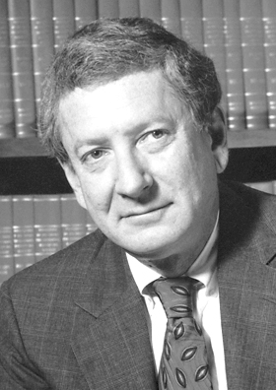
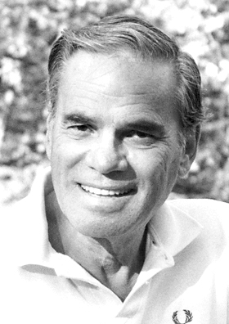
G Proteins
Nobel Prize for Physiology and Medicine in 1994
“…for their discovery of G Proteins and the role of these proteins in signal transduction in cells”
Alfred G. Gilman
UT Southwestern
Martin Rodbell
NIH! (NIEHS)
Notes:
Rodbell – Necessity of GTP
Gilman – Identification of G Proteins

Slide 15
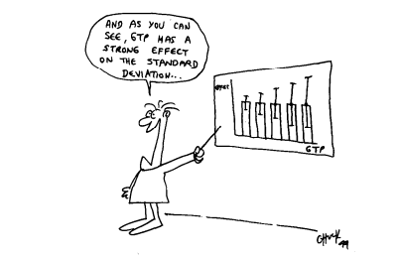
GTP controversy
Notes:
1971 cartoon by Pierre De Meytes – Gilman’s nobel lecture

Slide 16
α
βγ
Purple blob = GDP

Slide 17
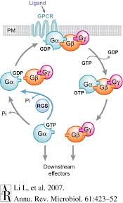
G Protein cycle
1. Receptor activation promotes exchange of GDP for GTP
2. Alpha and beta/gamma separate
SIGNALING
3. G alpha is auto-catalytic (GTPase)
GTP into GDP hydrolysis
RGS can speed hydrolysis and limit G Protein signaling
Notes:
The cycle is

Slide 18
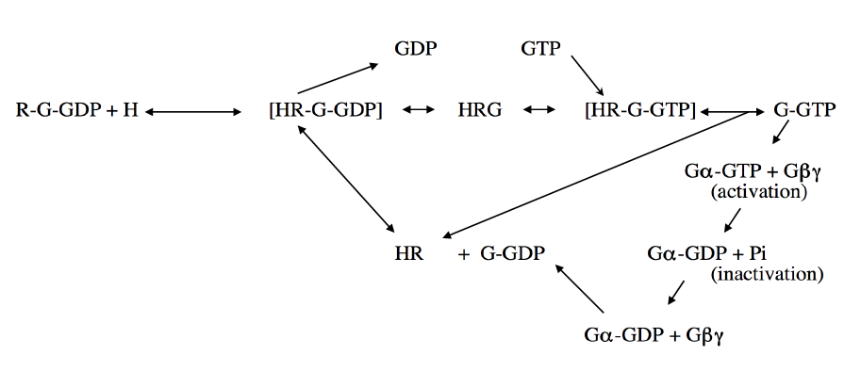
G Protein cycle – more realistic
Notes:
Bring up constitutive activity

Slide 19
Not all G Proteins are created equal
G Protein classes are defined by their alpha subunits
G_{t} – transudcin (vision)
G_{s} – stimulatory (adenylyl cyclase)
G_{i/o} – inhibitory (adenylyl cyclase)
G_{q} – the q was arbitrary
G_{olf} - olfactory

Slide 20
GPCR endogenous ligands
Hormones:
Estrogen
Oxytocin
Sensory:
Odors
Tastes
Photons
Other:
Calcium
Cannabinoid
Adenosine
Histamine
+ more! Way more…
Orphans
Amines:
Dopamine
Norepinephrine
Serotonin
Peptides:
Opioids
Leptin
Ghrelin
Neurotransmitters:
Glutamate
GABA
ACh

Slide 21
Dopamine Receptors
5 Dopamine Receptors
D1
D2
D3
D4
D5
2 classes
D1-like (D1, D5)
G_{s}
D2-like (D2, D3, D4)
G_{i/o}

Slide 22
GPCR endogenous ligands
Hormones:
Estrogen
Oxytocin
Sensory:
Odors
Tastes
Photons
Other:
Calcium
Cannabinoid
Adenosine
Histamine
+ more! Way more…
Orphans
Hormones:
Estrogen
Oxytocin
Sensory:
Odors
Tastes
Photons
Other:
Calcium
Cannabinoid
Adenosine
Histamine
+ more! Way more…
Orphans
Amines:
Dopamine
Norepinephrine
Serotonin
Peptides:
Opioids
Leptin
Ghrelin
Neurotransmitters:
Glutamate
GABA
ACh
Amines:
Dopamine
Norepinephrine
Serotonin
Peptides:
Opioids
Leptin
Ghrelin
Neurotransmitters:
Glutamate
GABA
ACh
Each of these has different receptors with different G Proteins!
So just imagine the signaling variability!!!
Notes:
So many combinations of GPCRs and G Proteins

Slide 23
Discussion
What are some ways to add further diversity?
Notes:
One answer: different effectors depending on agonist or effector complexing / interaction

Slide 24
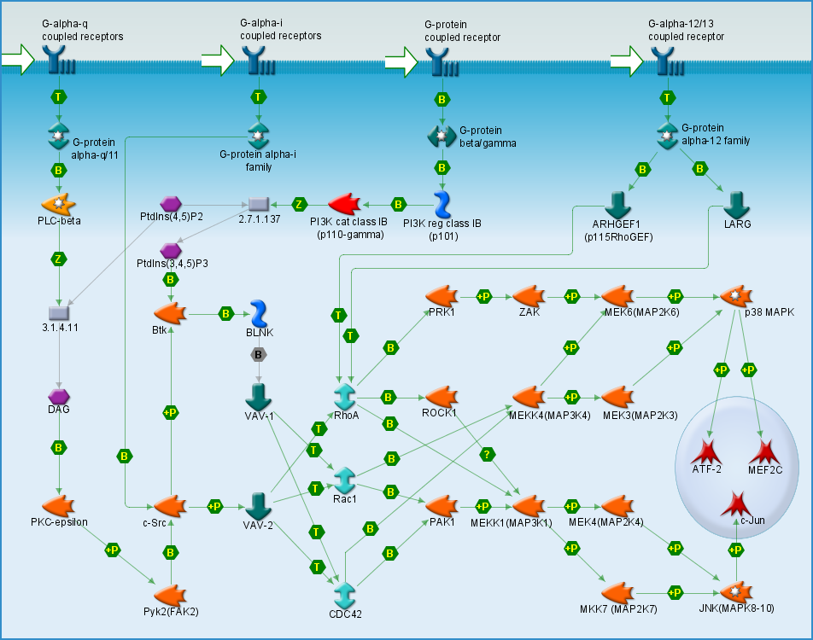
Effectors
The targets of G Protein signaling are … diverse and interconnected
Notes:
Don’t go over this! It is to show what you’ll see when you google GPCR effectors and how many pathways there are. It’s an example of bad data displays. But shows just how big an influence GPCRs can exert.

Slide 25
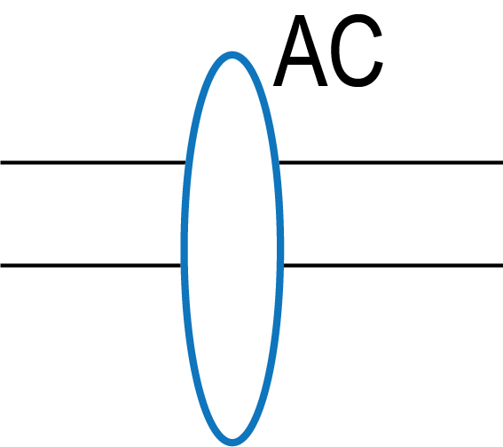
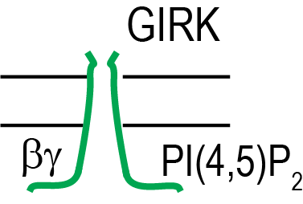
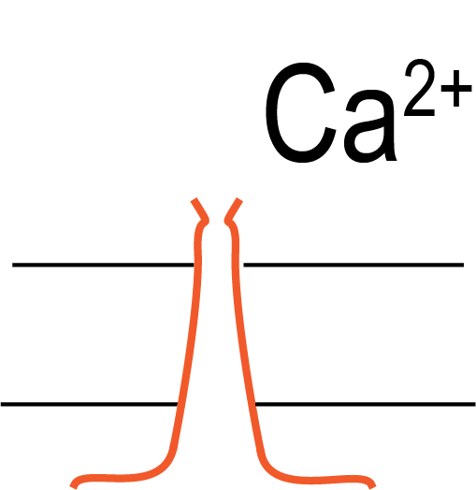
Effectors – simplified
Adenylyl Cyclase
GIRK channels
Calcium channels
Phospholipase C (PLC)
α
βγ
α
βγ
Notes:
Two example GPCR classes

Slide 26
Effectors – Dopamine Receptors
Hyperpolarization
Slow / pause firing
D2-R
Inhibit cAMP production
Inhibit PKA activity
α
Voltage-gated calcium channels
Decrease calcium currents
Inhibit neurotransmission

Slide 27
Effectors – Dopamine Receptors
Catalyze cAMP production
Activate PKA
D1-R
α
Voltage-gated calcium channels
Increase calcium currents
Enhance neurotransmission

Slide 28
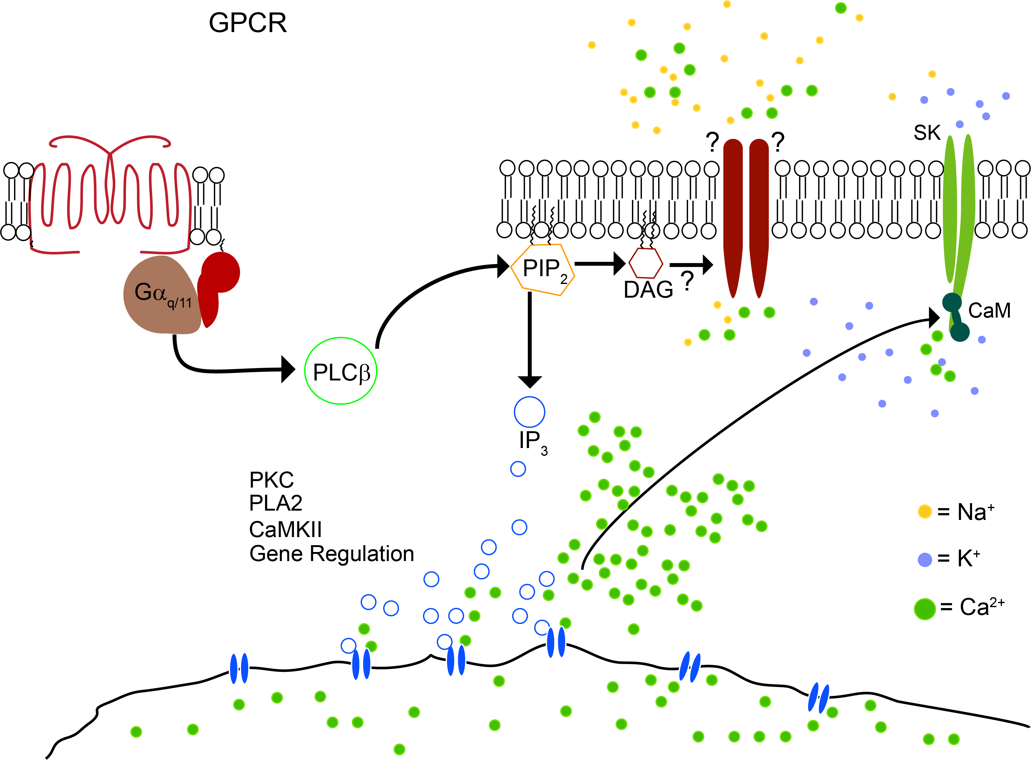
Effectors – Glutamate Receptors (G_{q})
SK inhibition
Cation excitation
PKC
PLA₂
CaMKII
Gene Regulation

Slide 29
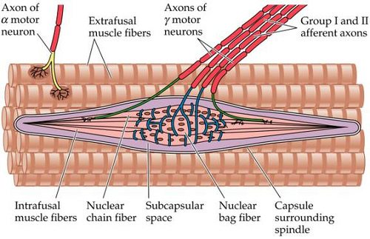
Stretch Break – 5 minutes!

Slide 30
Outline today
GPCR overview
G Proteins
GPCR exemplars
BREAK!
Physiological roles – modulation!
Recent developments
How are they activated?

Slide 31
Outline today
Physiological roles – modulation!
Postsynaptic
Presynaptic
Modulation of modulation (metamodulation?)

Slide 32
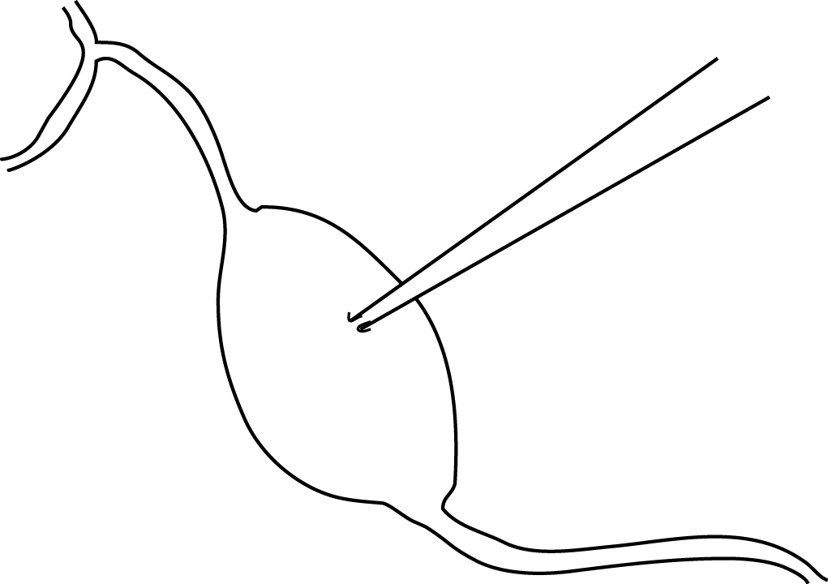
Postsynaptic
Extracellular recording of action potentials
Bender, K., … & Trussell, L., J. Physiology, 2012
Notes:
Look at spontaneous firing of cartwheel cells of the dorsal cochlear nucleus

Slide 33
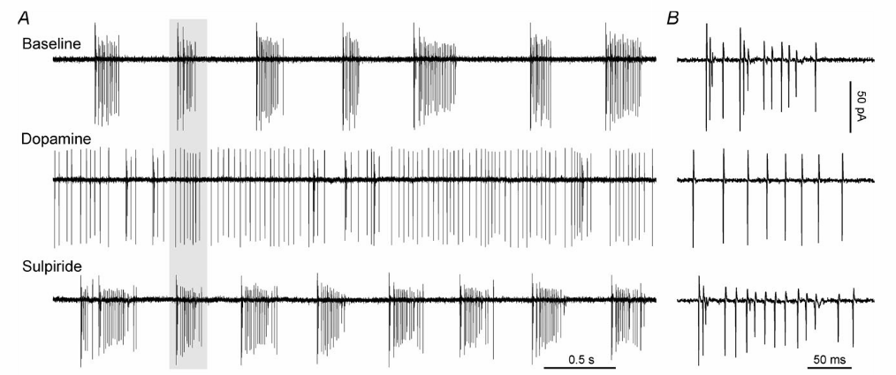


Postsynaptic
Extracellular recording of action potentials
Bender, K., … & Trussell, L., J. Physiology, 2012
Notes:
Look at spontaneous firing of cartwheel cells of the dorsal cochlear nucleus

Slide 34
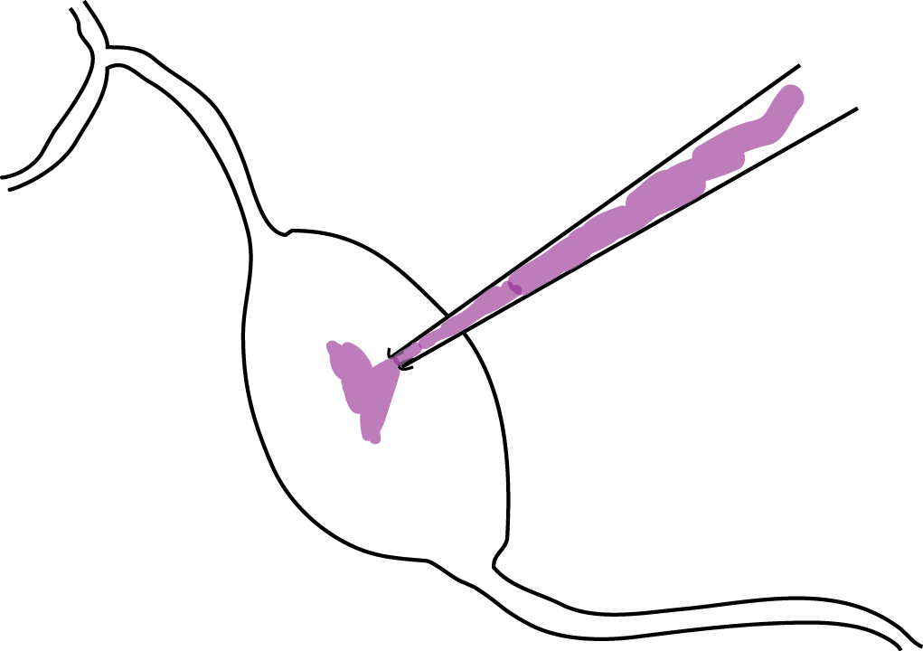
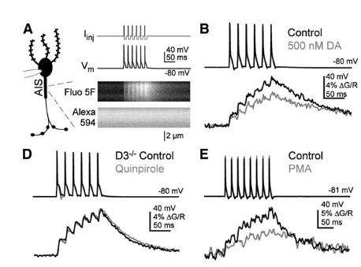
Postsynaptic
Whole-cell recording: imaging calcium, stimulating APs
Bender, K., Ford, C. & Trussell, L., Neuron, 2010
Notes:
Look at spontaneous firing of cartwheel cells of the dorsal cochlear nucleus

Slide 35
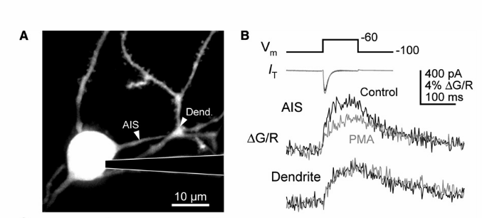
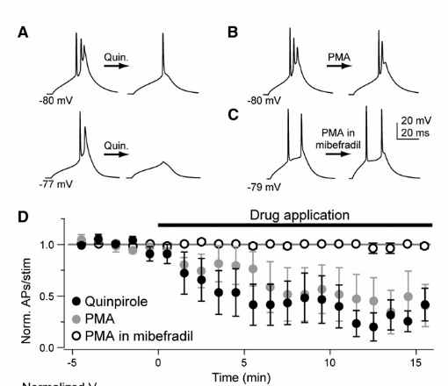
Postsynaptic
Bender, K., Ford, C. & Trussell, L., Neuron, 2010
Notes:
Look at spontaneous firing of cartwheel cells of the dorsal cochlear nucleus

Slide 36
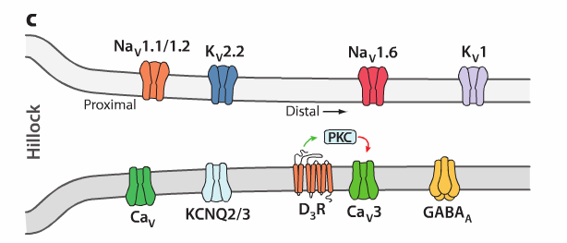
Postsynaptic
In these cells, dopamine decreases burst firing through D3 receptor activation with a local and specific mechanism
Bender, K. & Trussell, L., Ann. Rev. Neuro., 2012
Notes:
Look at spontaneous firing of cartwheel cells of the dorsal cochlear nucleus

Slide 37
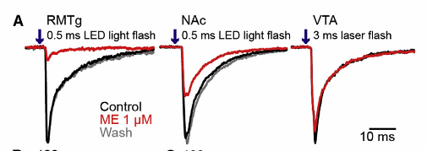
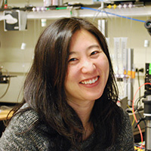
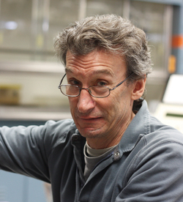
Presynaptic
VGCC
Matsui, A., … & Williams, J. Neuron, 2014

Slide 38


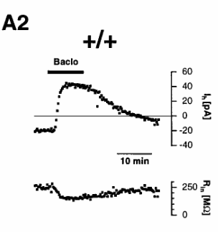
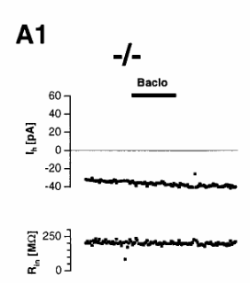
Presynaptic inhibition is independent of GIRK ^{(in CA1, CA3 hippocampus)}
Luscher, C. … & Nicoll, R. Neuron, 1997

Slide 39
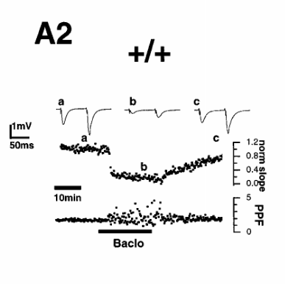
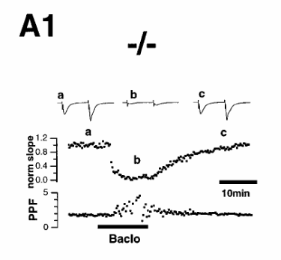
Presynaptic inhibition is independent of GIRK ^{(in CA1, CA3 hippocampus)}
Luscher, C. … & Nicoll, R. Neuron, 1997

Slide 40
Presynaptic inhibition is independent of GIRK ^{(in CA1, CA3 hippocampus)}
GIRK
VGCC

Slide 41
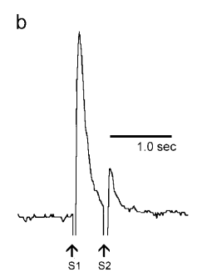
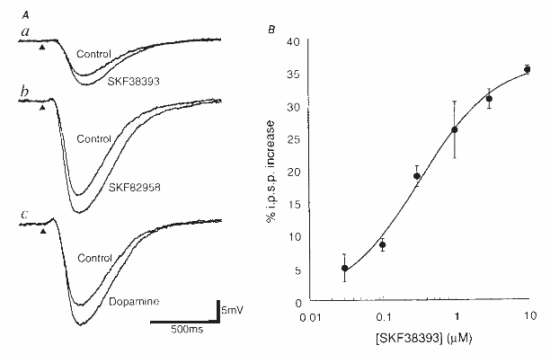
Presynaptic terminology
autoreceptor
heteroceptor
Phillips et al., 2002 Synapse
Cameron and Williams, 1993 Nature
Notes:
Left is amperometry looking at paired pulse dopamine release. Showing PPD. Left is dopamine D1 receptor activation enhancing glutamate release through AC -> PKA

Slide 42
Modulation of GPCR signaling
G Protein Receptor Kinases (GRKs)
Arrestin
Regulators of G Protein Signaling (RGS) Proteins

Slide 43
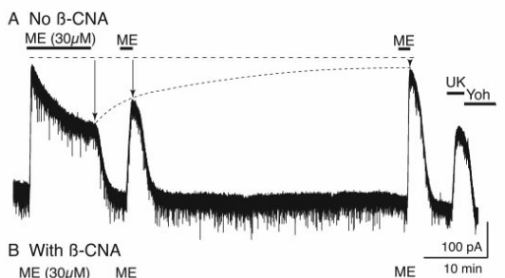
GRK and Arrestin
Acute receptor desensitization: In the continued presence of agonist, signal declines
Prolonged desensitization: Smaller signal to same test
Virk and Williams, Mol. Pharm, 2008

Slide 44
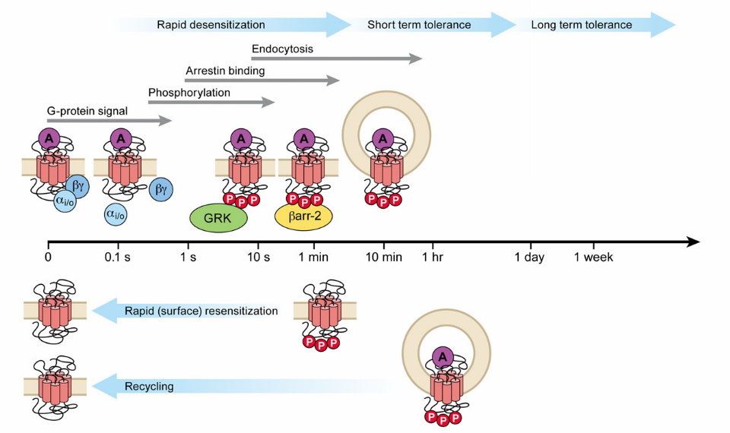
GRK and Arrestin
Williams, J.T. et al., 2013 Pharm. Rev.

Slide 45
RGS in the G Protein cycle
1. Receptor activation promotes exchange of GDP for GTP
2. Alpha and beta/gamma separate
SIGNALING
3. G alpha is auto-catalytic
GTP into GDP hydrolysis
RGS can speed hydrolysis and limit G Protein signaling
RGS = Regulator of G Protein Signaling
Notes:
The cycle is

Slide 46

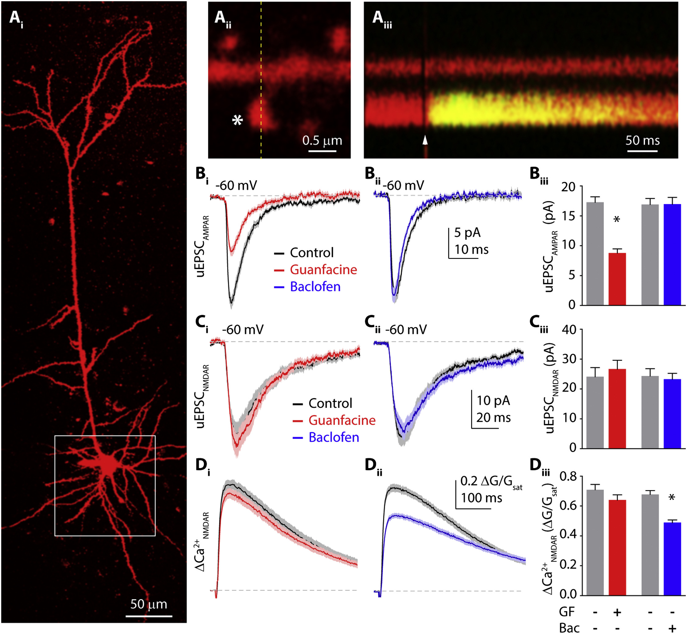
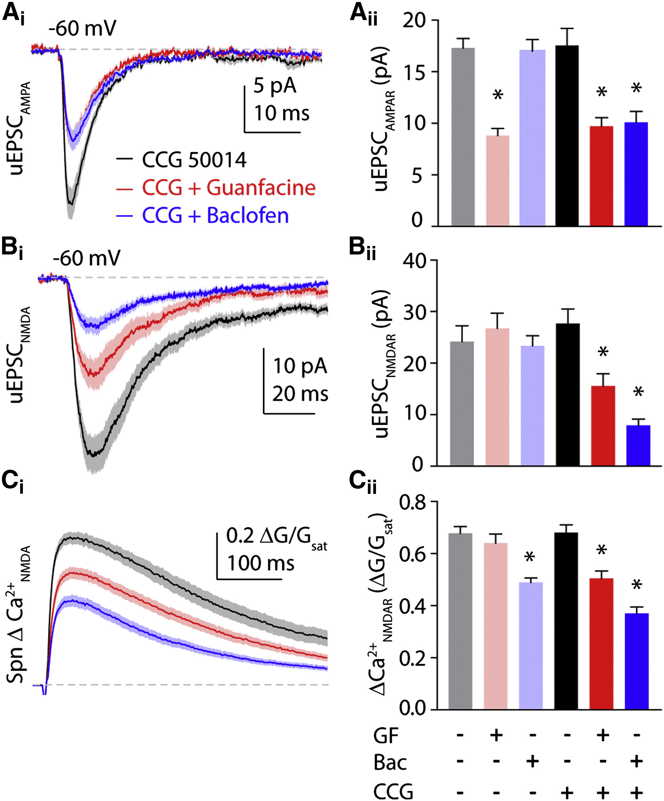
RGS proteins
Red: activate α2-R
Blue: activate GABA-B receptor
Now, inhibit RGS-4
Lur, G. & Higley, M. Cell Reports, 2015

Slide 47
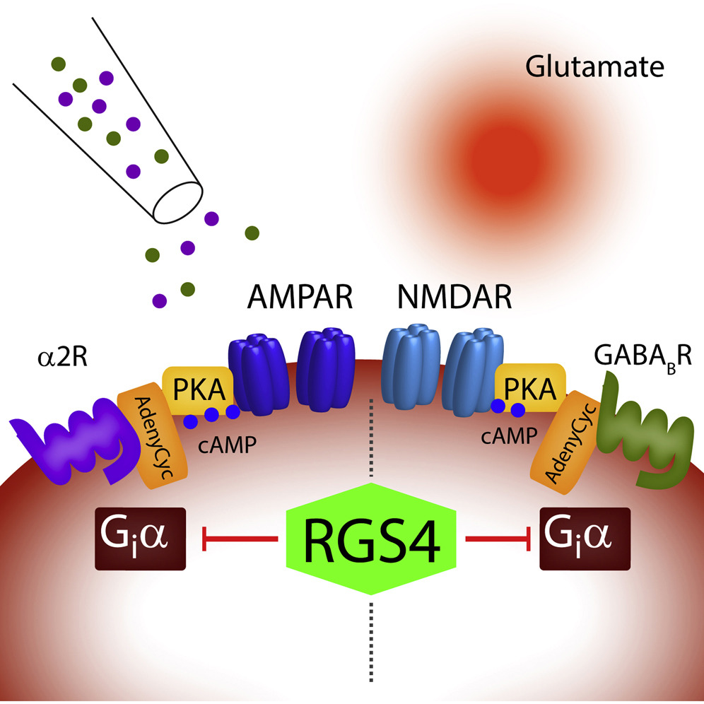
RGS proteins

Slide 48
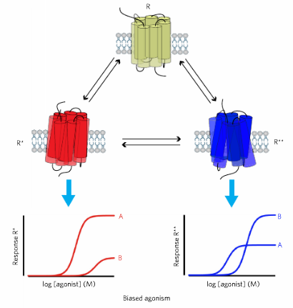
The new stuff: biased agonism

Slide 49
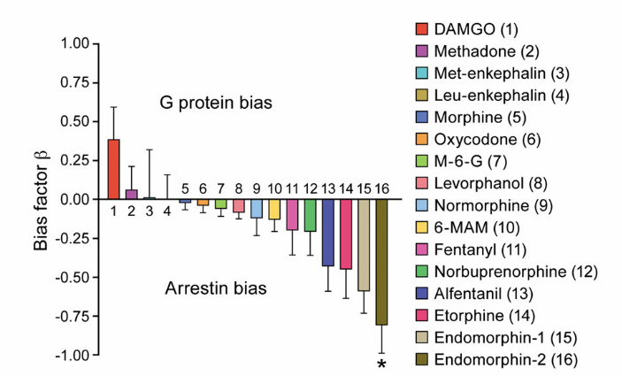
The new stuff: biased agonism

Slide 50
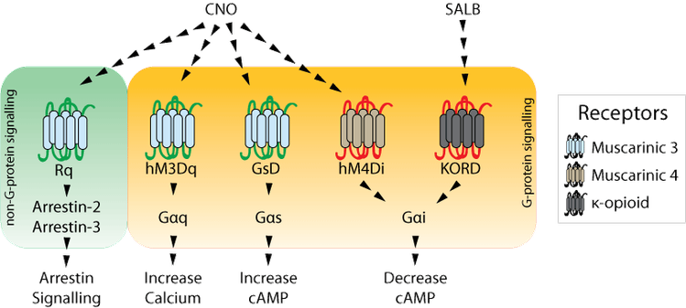
The new stuff: DREADDs
Designer receptors exclusively activated by designer drugs
Source: addgene.com

Slide 51
Contact information
paul.kramer@nih.gov

Slide 52
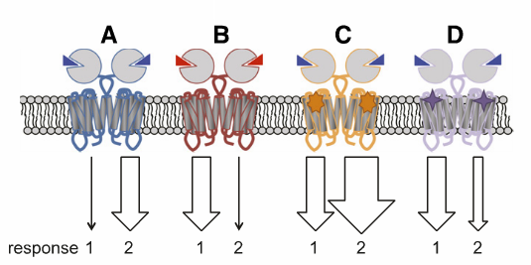
The new stuff: allosteric modulation
Allosteric modulators bind to site other than orthosteric agonist
Enhance or depress activity without activating receptors, or enhance certain biased pathways
Target for drug development due to no direct activation of receptors

Slide 53
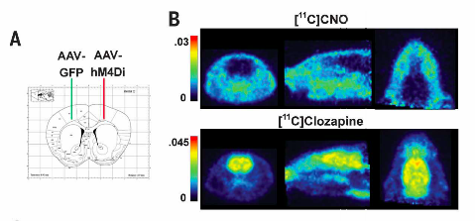
The new stuff: DREADDs BE CAREFUL
Recent paper shows:
CNO doesn’t cross the BBB as well as clozipine (metabolite)
Gomez et al., Science 2017

Slide 54
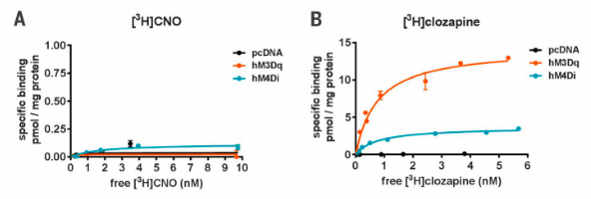
The new stuff: DREADDs BE CAREFUL
Recent paper shows:
Clozizpine binds with high affinity to DREADDs
Gomez et al., Science 2017

Slide 55
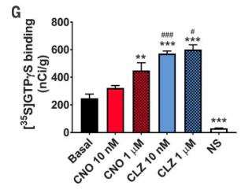
The new stuff: DREADDs BE CAREFUL
Recent paper shows:
Clozipine potently activates DREADDS
Gomez et al., Science 2017

Slide 56
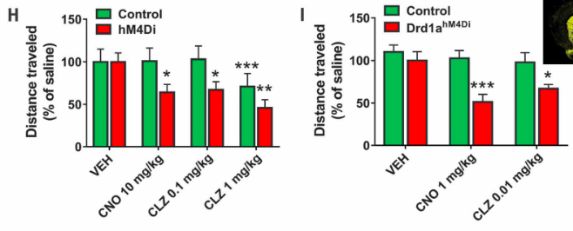
The new stuff: DREADDs BE CAREFUL
Recent paper shows:
Clozipine elicits “DREADD-specific” behaviors
Gomez et al., Science 2017

